Slide 1
IE451 Data Analytics and Optimization
Erhun Kundakcıoğlu

Slide 2

Today…
Should
I be here?
Go through the Syllabus
Basic terminology and an overview of data mining as it relates to operations research
Why one should give more emphasis to data analytics?

Slide 3
IE451 Data Analytics and Optimization
Syllabus

Slide 4
Syllabus
The syllabus is posted on SuCourse. Please read it carefully because this is a binding contract.
Instructor: Erhun Kundakcıoğlu Office: FENS L024 Tel: 0 (216) 483-9586 E-mail: erhun.kundakcioglu@sabanciuniv.edu Office Hours: Wednesdays 15:30-17:00 via appointment at https://erhun.me/docs/contact/
TA: Müge Dedeoğlu E-mail: muge.dedeoglu@sabanciuniv.edu Office Hours: TBA

Slide 5







Biography
BS IE 2002
MS IE 2004
PhD IE (CS Minor) 2009
Research/Teaching Interests
Linear/Integer Programming
Data Analytics
Decision Support Systems

Slide 6
Syllabus – Learning Outcomes
Apply the basic concepts of existing methodologies for data visualization and analysis, as well as machine learning.
Model and interpret data, by applying statistics, information visualization, and machine learning techniques.
Extract and clean data from diverse domains.
Explore data through visualizations.
Conduct challenging technical projects that involve intense data analysis and interpretation.
Apply their knowledge on the best-practices in the real world, regarding the application of theory.
Work independently, as well as in a team, in completing challenging data analysis projects.

Slide 7
Course Content
Introduction
Validation
Classification
Regression
Clustering
Association Rule Mining
Data Understanding & Visualization
Data Preprocessing
Meta Heuristics
Feature Subset Selection
Feature Extraction
Neural Networks

Slide 8
Syllabus – Scoring
Quizzes 4 x 5% | Midterm 35% | Final 45%
Midterm exam and quizzes will be during lecture hours
Will be announced at least a week in advance
Letter grades will be assigned based on the bell curve.
There will be a minimum required total score of 40% to pass the course.
A note on my perspective on attendance and extra grade.
In class discussions with implementation of algorithms discussed in the lecture (in Python).

Slide 9
Syllabus – Policies
Course Materials:
No particular text book. Lecture materials, including the class overheads, readings, assignments etc. will be posted to SuCourse. Students are expected to check the web site regularly.
Objection Policy:
Concerns regarding graded work must be submitted within one week of the date the grade is released over Gradescope only.
Make-up Policy:
There will be no make-up for the quizzes. A make-up midterm (final) exam will be given for students missing the midterm (final) exam due to a medical excuse before (after) the final period.
Academic Conduct:
Do not plagiarize other people’s work. Students should be aware that anyone who engages in actions prohibited by the University’s policy on academic honesty will be subject to disciplinary action.

Slide 10
Syllabus – Policies
Technology Requirements:
Students will need to model, implement and solve programs in lectures. We will use Jupyter Notebook and Gurobi solver with Python interface.
AI/LLM Usage Policy:
Use of AI tools during class for any graded task is strictly prohibited. Students are not permitted to use AI-based tools (such as ChatGPT, Claude, Bard, Grammarly, or similar platforms) for any part of the graded assignments. This prohibition includes -but is not limited to- brainstorming, outlining, drafting, editing, paraphrasing, or generating solutions. All submitted work must reflect each student’s own independent effort and original thought.
Outside of class, students are welcome to explore AI tools to aid their understanding of course concepts. However, please be aware that these tools may produce inaccurate or incomplete explanations, particularly for challenging problems. Students remain fully responsible for mastering the material and verifying their understanding.

Slide 11
IE451 Data Analytics and Optimization
Basics

Slide 12
The (Human) OODA Loop (*)
OBSERVE
ORIENT
DECIDE
ACT
Unfolding Circumstances
Cultural
Traditions
Implicit Guidance & Control
Implicit Guidance & Control
Genetic
Heritage
Analyses & Synthesis
Observations
Decision
Action
Feed Forward
Feed Forward
Feed Forward
New
Information
Previous
Experience
Feedback
Outside Information
Feedback
Unfolding Interaction with Environment
(*) Developed by strategist and United States Air Force Colonel John Boyd

Slide 13
Enabler Technologies of Digitalization
Internet of Things
Cloud/Edge Computing
Blockchain
Cyber Security
Artificial Intelligence
Digital Twins
Data Driven Manufacturing
Additive Manufacturing / 3D Printing
Smart Robotics / Cyber Physical Systems
Virtual Reality / Augmented Reality / Mixed Reality

Slide 14
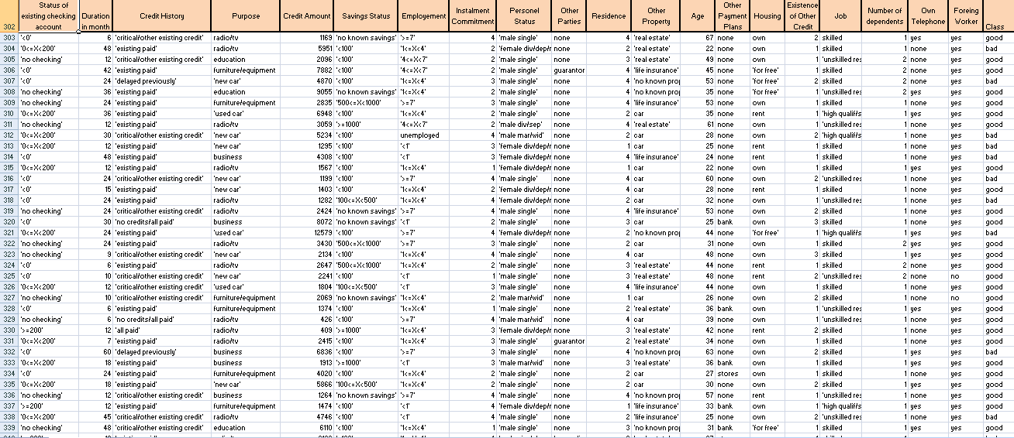
Data Analytics
Data: Raw metrics. As is meaningless. Should be processed in order to create value.

Slide 15
Data Analytics
Data: Raw metrics. As is meaningless. Should be processed in order to create value.
Data Analytics: Giving meaning to data. The process of bringing out the hidden information (i.e., patterns) buried in the data in order to create value (decide & act).

Slide 16
Data Analytics
Analyzing the data in order to make informed decisions & create value.
Data Analytics have three subdivisions:
Descriptive Data Analytics – Giving Meaning to Data, i.e., Orient (Mostly utilize basic and intermediate level techniques)
Predictive Data Analytics - Giving Meaning to Data, i.e., Orient (Mostly utilize advanced techniques)
Prescriptive Data Analytics – Orient & Decide (Mostly utilize advanced techniques) (The parameters, the constraints, the objective function etc. can be obtained by descriptive & predictive data analytics)

Slide 17
Descriptive Analytics
What happened and/or is happening? Why? (Sometimes the latter question is referred to as Diagnostic Analytics)
Data acquisition technologies (RFID, barcode, QR code, GPS etc.) provides the data used for the analysis.
Real Time Data including location, quantity, time, quality and other performance metrics is used for Descriptive Analytics.
Visualization, descriptive statistics, OLAP, reporting tools, clustering, etc. used for the analysis.
e.g., Tardiness/Lateness statistics of the jobs, average lead times of suppliers, total inventory/stock out ratios, sales/revenue change in previous years, etc.
Limited to analysis of the Sample (i.e., Historical Data)

Slide 18
Predictive Analytics
What will happen most likely?
Statistics, time series analysis, data mining & machine learning, simulations, etc.
Forecasting demand/sales
Change in customer behavior (e.g., churn analysis)
Fill in the missing data that you don’t have for further analysis
Recommendation systems
Predictive maintenance
…,etc.
Use the Sample/Historical Data for inferring the Population (i.e., from sample statistics to population parameters)

Slide 19
Prescriptive Analytics
What should be happening? How to make sure that it happens?
Optimization (mathematical programming, heuristics/metaheuristics, etc.), simulations, multi criteria decision making, etc.
e.g., Optimize scheduling, production and inventory in supply chain, pricing, resource allocation, vehicle routing and planning, supplier selection, transportation mode selection, facility location, etc.,
In a nutshell Prescriptive Analytics is data driven decision making, i.e., heart of what we call Artificial Intelligence.

Slide 20
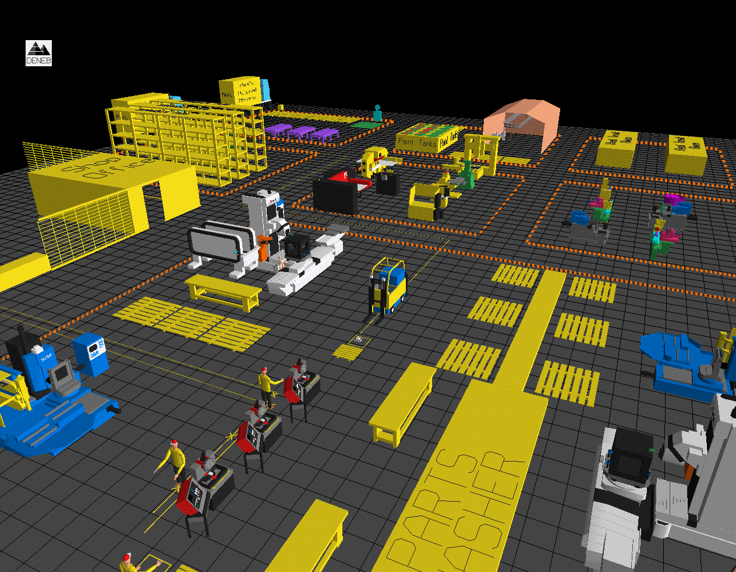
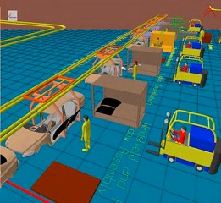
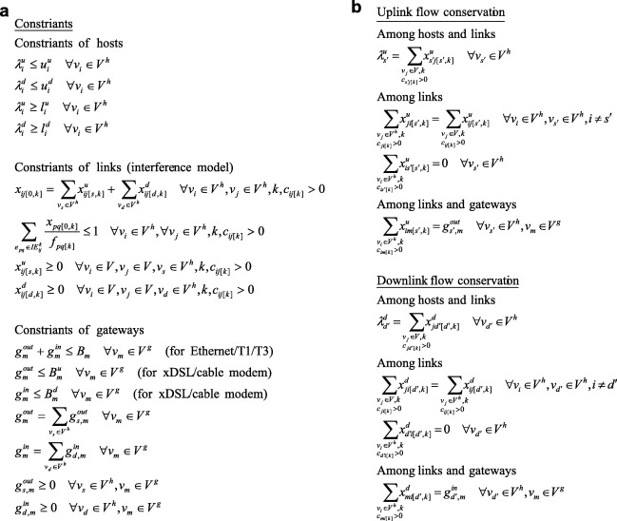
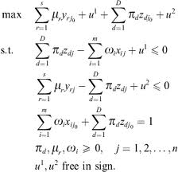
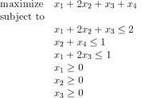
Modeling Decisions
Objective
Alternatives

Slide 21

Metaheuristics
EUREKA: I found!
Heuristic finds good feasible solution(s) but not necessarily optimal for a particular problem.
Metaheuristics are umbrella heuristics that can be applied to many different decision making problems.

Slide 22
Metaheuristics
Genetic Algorithms
Simulated Annealing
Tabu Search
Beam Search
Variable Neighborhood Search
Ant Colony Algorithms
Migrating Bird Algorithms
….

Slide 23
Data Analytics
What should happen in order to…?
VALUE
Prescriptive
What will happen?
Decide Act
Predictive
Why?
What happened?
What is happening?
Diagnostic
Hindsight Insight Foresight
Descriptive
Data (Observe) Information (Orient)
DIFFICULTY

Slide 24
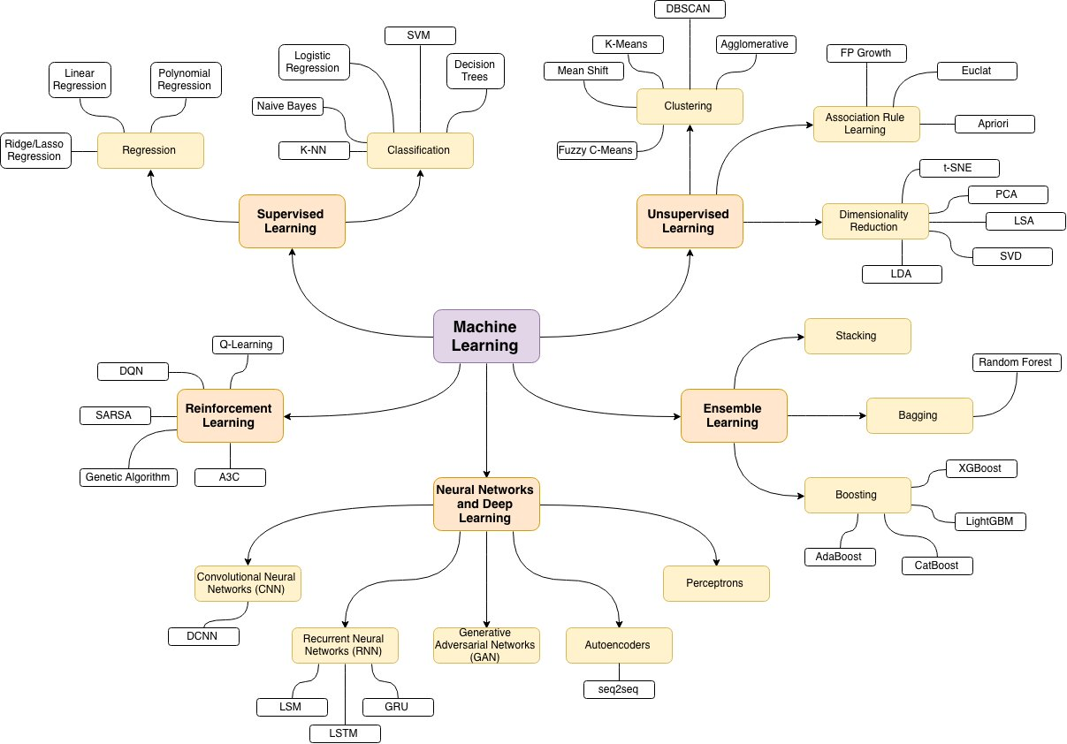

Machine Learning
A mind map of ML algorithms created by MIT’s CS & AI Lab (2024)
Source: https://twitter.com/MIT_CSAIL/status/1758899468760465569/photo/1

Slide 25
Machine Learning
A mind map of ML algorithms created by MIT’s CS & AI Lab (2024)
Source: https://twitter.com/MIT_CSAIL/status/1758899468760465569/photo/1

Slide 26
What is Artificial Intelligence?
Observe
Orient
Decide
Act
HUMANS | Hear, See, Smell, Touch, Taste |  |  | Move, Speak
MACHINES | Collect Data |  |  | Actuate, Communicate
Human Intelligence
Artificial Intelligence
“Narrow AI”
“General AI”
Computer achieves human or superhuman intelligence on specific tasks or in limited environments
Computer achieves human or superhuman intelligence over the full range of cognitive tasks
Today
Decades from today?
Taken from Robert A. Bond’s Presentation which is Adapted from “Preparing for the Future of Artificial Intelligence,” National Science and Technology Council, Oct 2016

Slide 27
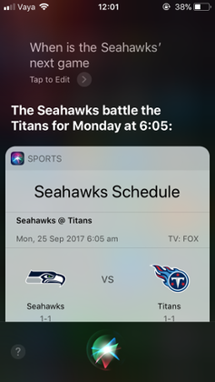
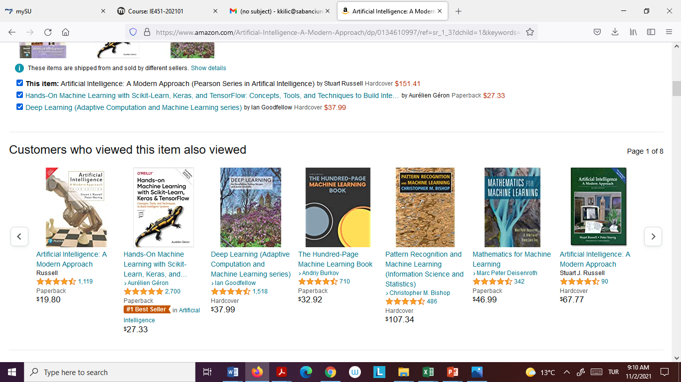
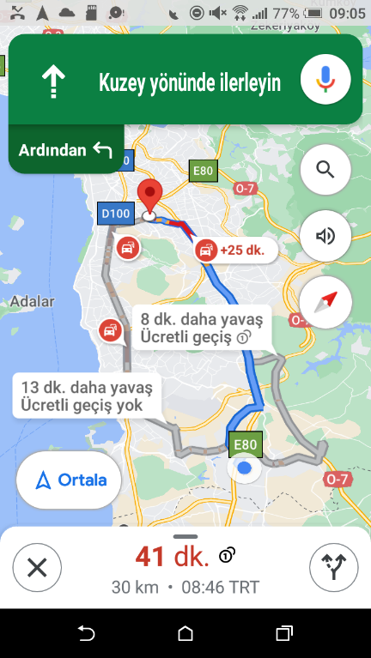
Artificial Intelligence Everywhere
Apple’s Siri talking
with us
Amazon, recommendation system
Google Maps
Finds the best route for us
…And others, e.g., providing financial advice (Schwab’s Intelligent Portfolio), expert second opinion for cancer patients (IBM’s Watson)...

Slide 28
Artificial Intelligence
John McCarty (Stanford) coined the term in Dartmouth Conference (1956) where the aim is stated as:
"...An attempt will be made to find how to make machines use language, form abstractions and concepts, solve kinds of problems now reserved for humans, and improve themselves. We think that a significant advance can be made in one or more of these problems if a carefully selected group of scientists work on it together for a summer…" (*)
(*) John McCarthy, Marvin Minsky, Nathan Rochester, and Claude Shannon, “A Proposal for the Dartmouth Summer Research Project on Artificial Intelligence” (1955)

Slide 29
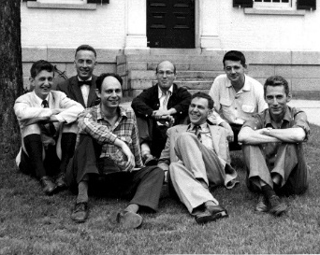
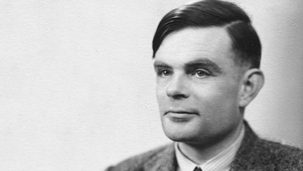

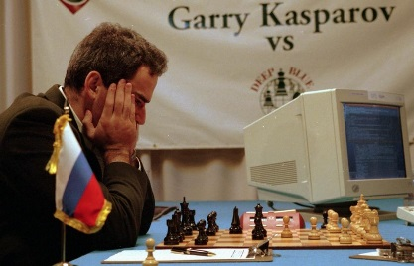
Brief History of Artificial Intelligence
Early AI
Machine Learning
Deep Learning
1956 – Dartmouth Conference
2017 – Skin Cancer Detection
2016 – AlphaGo
1950 – Turing Test
“Can machines think?”
1997 – Deep Blue
Alan Turing
Marvin Minsky – Claude Shannon
Ray Solomonoff – And Others
Lee Sedol
Garry Kasparov
1950
1960
1970
1980
1990
2000
2010
2020
1950 – Alan Turing, “Can machines think?”
1956 – John McCarthy coins term Artificial Intelligence
1959 – MIT Artificial Intelligence Project
1979 – Stanford Cart navigates room
1982 – First Expert System DENDRAL
1986 – First self-driving car
1997 – Deep Blue defeats Kasparov
2011 – Watson defeats Jeopardy! champions
2016 – AlphaGo defeats top pro
2015 – Program plays Atari games
2016 – Image recognition
2017 – Libratus defeats top Poker players
*human or super-human performance
2017 – Skin cancer classification
Recent breakthroughs have begun to fulfill the promise of artificial intelligence (Third Wave)
2017 – Speech Recognition
Adapted from 2017 AI Index Report

Slide 30

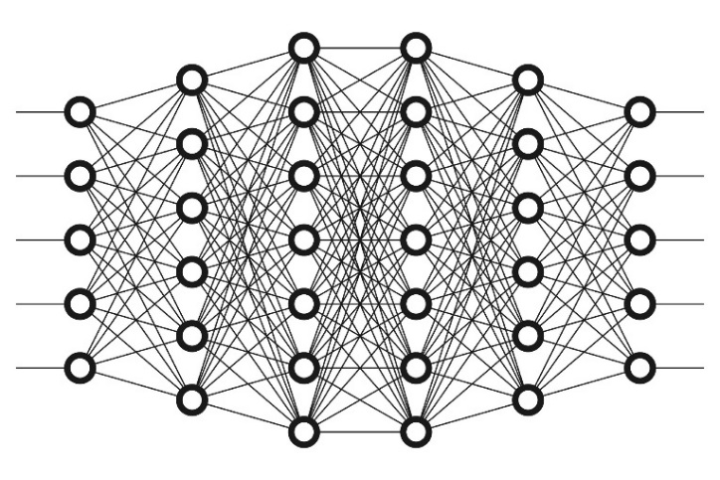
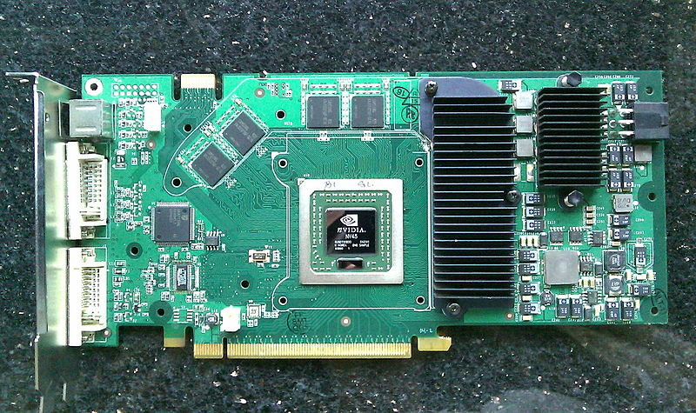
Technologies Underlying Recent Progress in AI
Big Data
Machine Learning Algorithms
Compute Power
“…deep learning will not only enable us to build more intelligent machines, but will also help us understand human intelligence and the mechanisms of human learning.”
Yann LeCun, Pioneer of Deep Learning

Slide 31


Slide 32
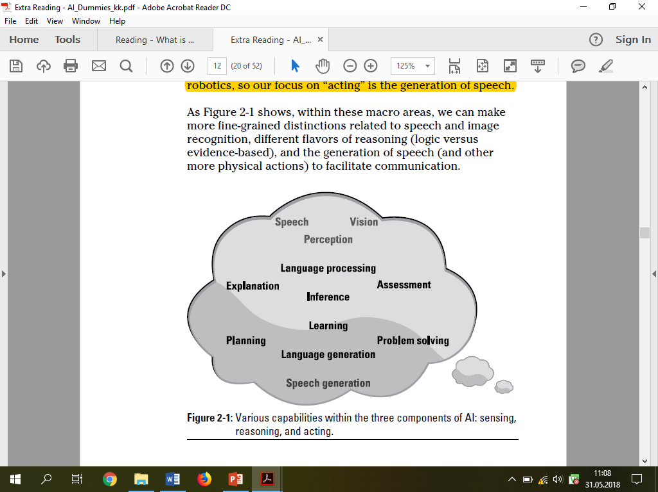
Sensing, Reasoning and Acting

Slide 33
Sensing (Observe → Orient)
Taking in sensor data about the world, and prepare it for the orientation (i.e., giving meaning to data) including:
Image processing: Recognizing important objects, paths, faces, cars, kittens, defects, or SKU’s in the inventory.
Speech recognition: Filtering out the noise and recognizing specific words, orders, etc.
Other sensors: Mostly for robotics; sonar, accelerometers, balance detection, and so on.

Slide 34
Reasoning (Orient → Decide)
Thinking about how things relate to what is known; for example:
Language processing: Turning words into ideas and their relationships..
Logic‐based inference: Deciding that something is true because, logically, it must be true.
Situation assessment: Figuring out what is going on in the world at a broader level than the ideas alone.
Evidence‐based inference: Deciding that something is true based on the weight of evidence at hand.
Learning: Building new knowledge based on examples or examination of a data set.
Planning/problem solving: Figuring out what to do to achieve a goal.
Natural language generation: Given a communication goal, generating the language to satisfy it.

Slide 35
Acting (Decide → Act)
Generating and controlling actions, such as:
Speech generation: Given a piece of text, generating the audio that expresses that text.
Robotic control: Moving and managing the different effectors that move you about the world.

Slide 36
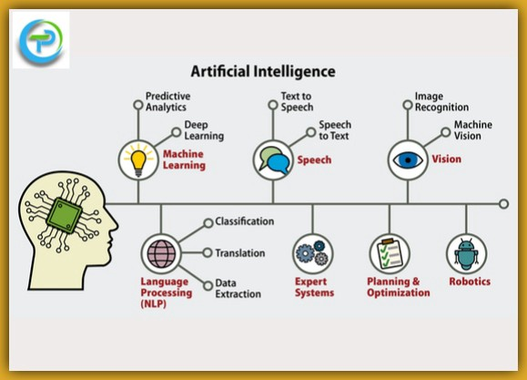
Major Core Units of AI
Taken from https://towardsai.net/p/artificial-intelligence/understanding-artificial-intelligence

Slide 37

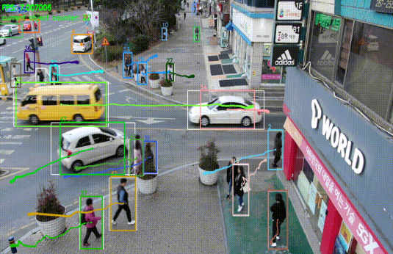
Computer Vision
Object movement and tracking
Object recognition and detection.
Taken from https://en.wikipedia.org/wiki/Object_detection#/media/File:Detected-with-YOLO--Schreibtisch-mit-Objekten.jpg

Slide 38
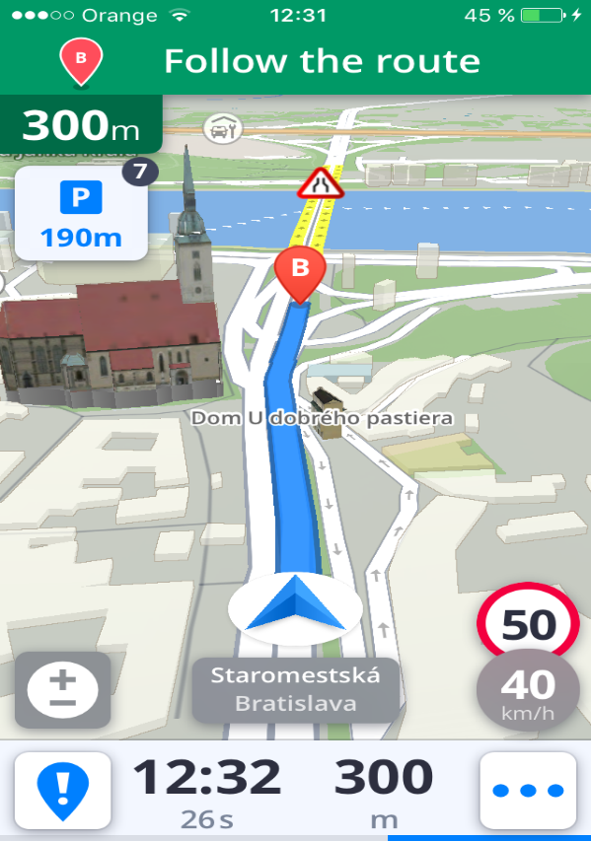

Speech Recognition
Speech Recognition
Speech Synthesis
Semantic Understanding
Taken from https://en.wikipedia.org/wiki/Object_detection#/media/File:Detected-with-YOLO--Schreibtisch-mit-Objekten.jpg

Slide 39

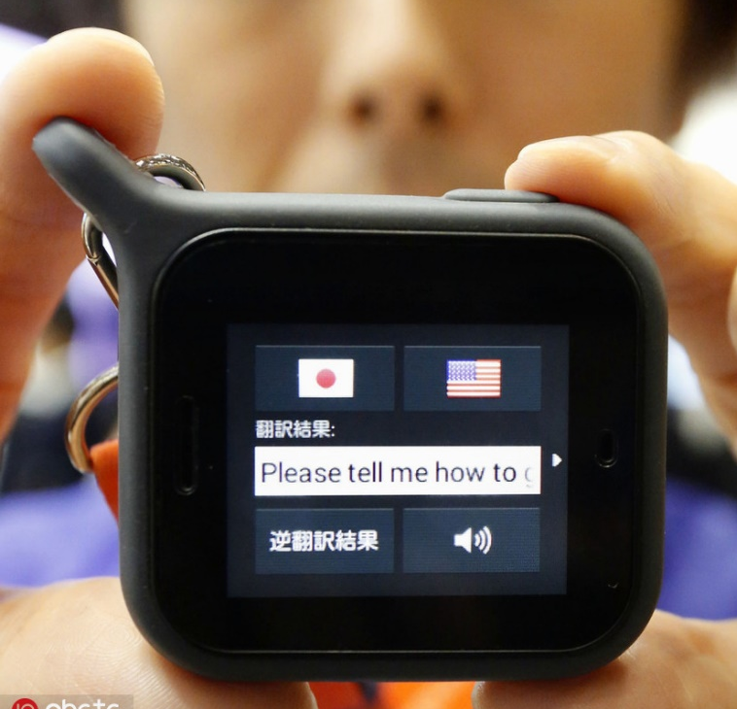

Natural Language Processing
Intelligent Customer Service
Computer Translation
Information Retrieval
Taken from https://en.wikipedia.org/wiki/Object_detection#/media/File:Detected-with-YOLO--Schreibtisch-mit-Objekten.jpg

Slide 40
Concepts Related to Artificial Intelligence
Optimization
Machine Learning
Calculus
Algorithms
Linear Algebra
Visualization
Artificial
Intelligence
Statistics
Database
Management
Notes:
10

Slide 41
Big Data vs. Structured Data
We have an explosive growth of data available to our machines (our systems have more to think about). This means that learning systems in particular that get better with more data can now look at billions of examples rather than a few hundred.
5 V’s of Big Data:
Volume (vast amount)
Velocity (speed of data generation)
Variety (diversity of data types)
Veracity (messiness and trustworthiness)
Value (usefulness)

Slide 42
Structured Data
m
1
k
y
X
n

Slide 43
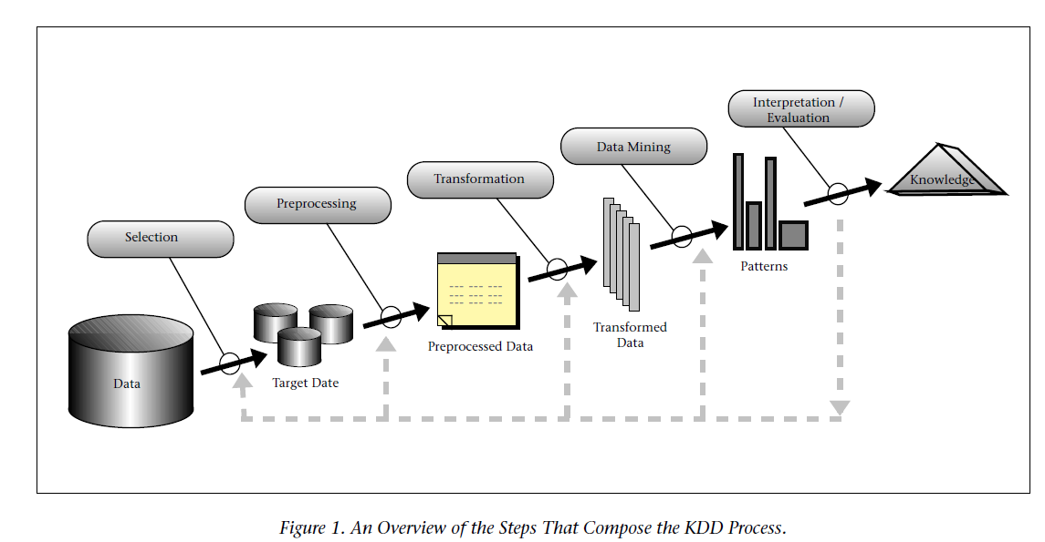
Knowledge Discovery in Databases (KDD)
Source: (Fayyad et al., 1996)

Slide 44
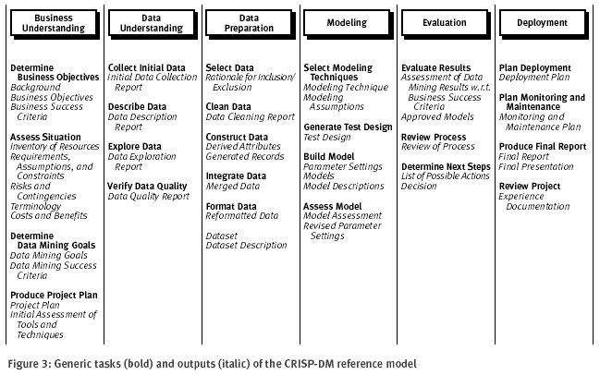
Cross Industry Standard Process for Data Mining (CRISP-DM)

Slide 45

Cross Industry Standard Process for Data Mining (CRISP-DM)
50-70% of total lifecycle time

Slide 46
Simplified KDD Process
Extracting meaningful, previously unknown patterns or knowledge from large databases
The knowledge discovery process:
Define
Objective
Prepare
Data
Mine
Knowledge
Interpret
Results
Business/scientific objective
Data mining objective
Data cleaning
Data selection
Feature selection
Visualization
Supervised Learning
Unsupervised Learning
Association Rules
Predictive models
Structural insights

Slide 47
CRISP-DM Operationalize KDD
KDD is the broader conceptual framework: it’s the classic “pipeline” for discovering knowledge from data
CRISP-DM is a practical, industry-oriented process model: it wraps the analytics/modeling work inside a business/project lifecycle (business understanding, deployment, iterative feedback, etc.).

Slide 48
Data Preparation
Incomplete Data
Untidy Data
Outliers
Imbalanced Data
Missing Data
Scales & Normalization of Data
Feature Subset Selection & Extraction

Slide 49
Feature Selection
Usually large number of attributes
Some attributes are redundant or irrelevant and should be removed
Benefits:
Faster subsequent induction
Simpler models (important in data analytics)
Better (predictive) performance of models
Discover which attributes are important (descriptive or structural knowledge)

Slide 50
Supervised Learning
m
1
X
Y
n
Independent Variables
Dependent Variable Label

Slide 51
Classification
Classification is the most common learning task in data mining
Many methods have been proposed
Decision trees, neural networks, support vector machines, logistic regression, etc.
The algorithm is trained on part of the data and the accuracy tested on independent data (or use cross-validation)
Optimization is relevant to many classification methods such as logistic regression, support vector machines, neural networks are all derived based on a particular optimization problem. Dependent variable (label) is discrete (aka class)

Slide 52
Classification
Example: Given old data about customers and payments, predict new applicant’s loan eligibility.
Previous customers
Classifier
Decision rules
Age
Salary
Profession
Location
Customer type (0 Default, 1 Paid on time)
Salary > X
Good / Bad
Prof = Exec
New applicant’s data

Slide 53
Regression
Regression is a set of statistical processes that are used to establish the relationship between variables.
It is used to understand how a variable changes with respect to the change in a particular variable given that the other variables are unchanged.
Unlike Multivariate Analysis where there is no particular differentiation among the variables, in regression some variables are treated as independent and some variables are treated as dependent variable.
Regression Analysis estimates the conditional probability distribution of the dependent variable given the independent variables.
Dependent variable (label) is continuous (aka response)

Slide 54
Unsupervised Learning
m
n
X

Slide 55
Unsupervised Learning
Now we do not have labeled data to train (unsupervised learning)
Want to identify natural clusters or groupings of data instances
Many possible set of clusters
Depending on how one defines "natural" the objective function changes thus the optimization formulation and the resulting solution algorithm changes.
Thus we have K-Means, K-Medians, E-M, DBSCAN, FCM etc.

Slide 56
Association Rule Mining
Given a set of transactions, find rules that will predict the occurrence of an item based on the occurrences of other items in the transaction
Market-Basket transactions
Example of Association Rules
{Diaper} → {Beer}, {Beer, Bread} → {Diaper},
{Milk, Bread} → {Beer, Coke},
Implication means co-occurrence, not causality!

Slide 57
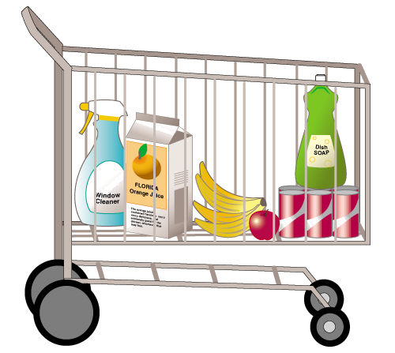
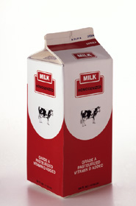
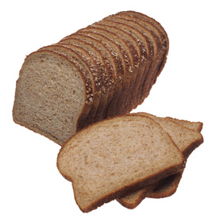
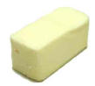
Association Rules
It is useful to mine the patterns in datasets where there is no input/output differentiation among the features.
The receipts in a grocery is a typical example of this type of transactional datasets.
There are rules such as “Whoever bought Bread and Butter also bought Milk”
That’s why it is usually referred to as the Market Basket Analysis.
+

Slide 58
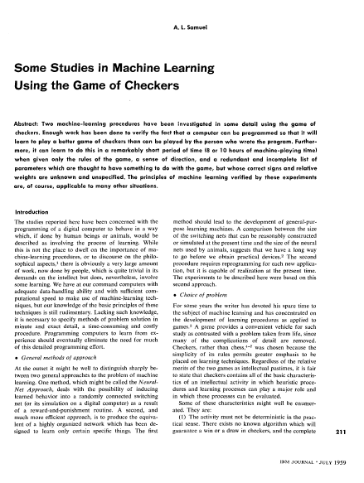
Machine Learning
Term coined in 1959 by Arthur Lee Samuel when he was in IBM Poughkeepside Laboratory.
Machine learning, in artificial intelligence (a subject within computer science), discipline concerned with the implementation of computer software that can learn autonomously. (Britannica)

